Slide 1
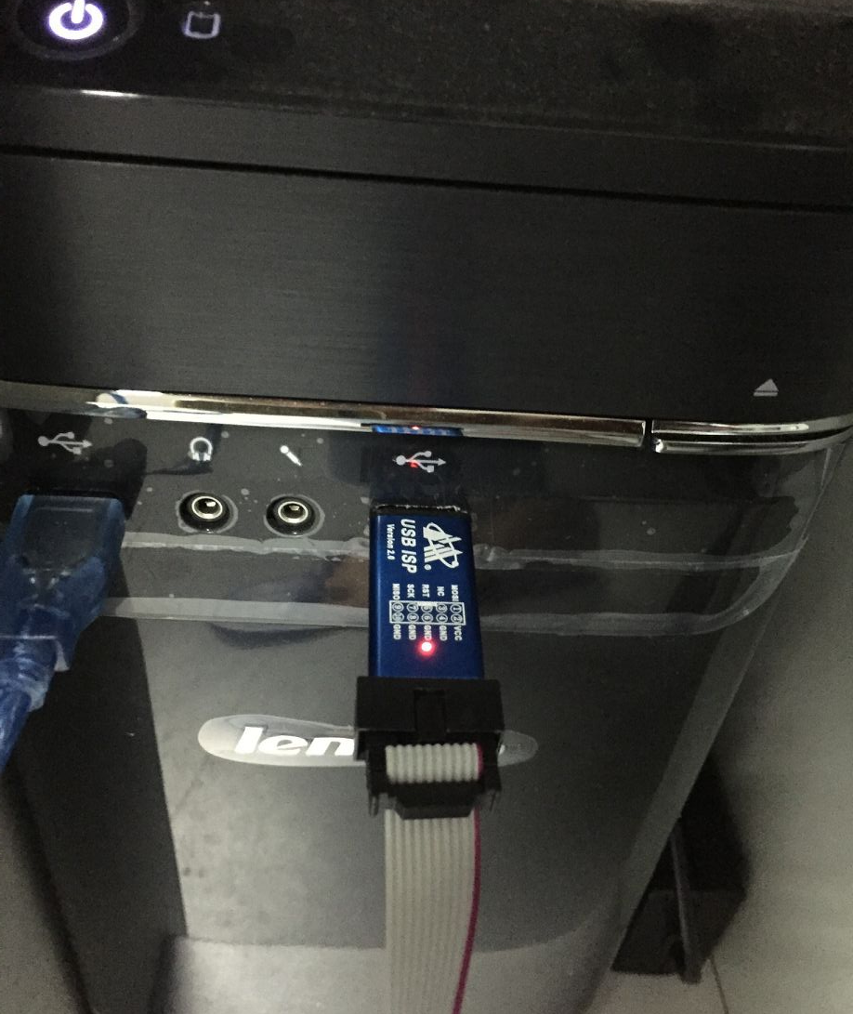
第一步，Firststep, connect usb with the computer !

Slide 2
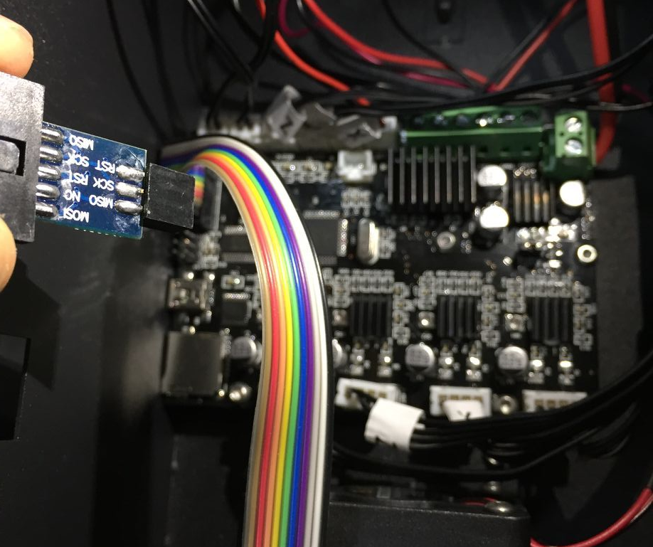
第二步，Second step,connect the other side with the motherboard, watch the direction!

Slide 3
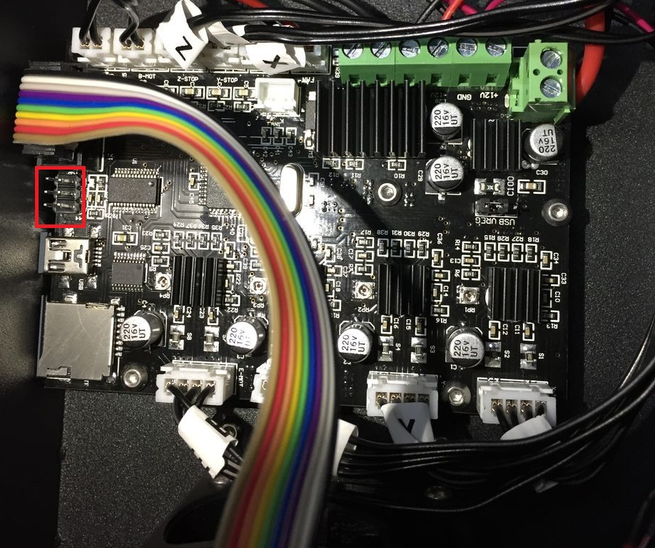
The location where connection happened, as following ：

Slide 4
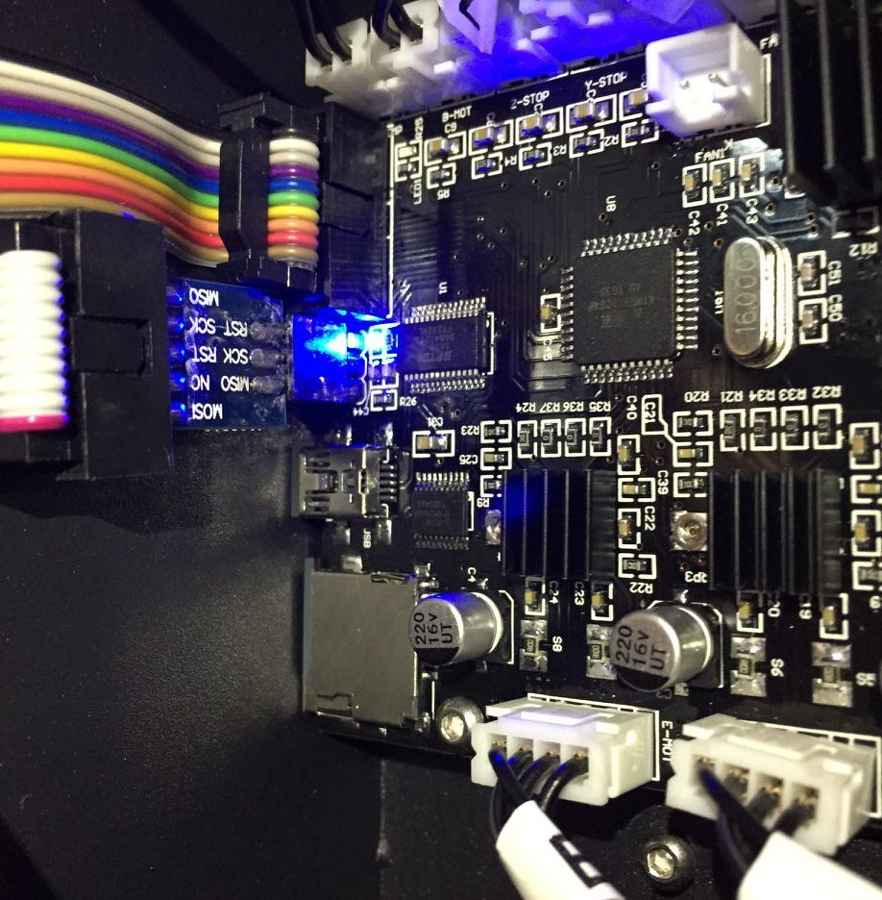
Whenconnect with motherboard, the light will light up, watch the direction, lcdlight normal, as following：

Slide 5
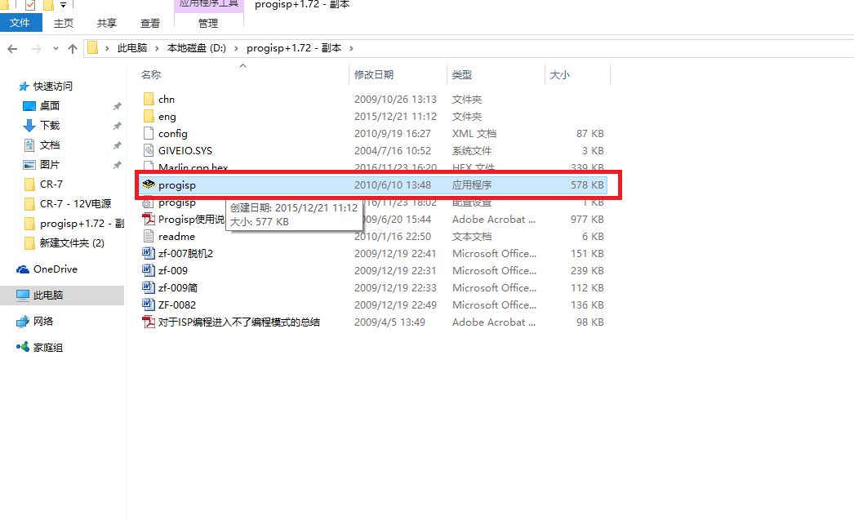
第三步，Open the download software

Slide 6
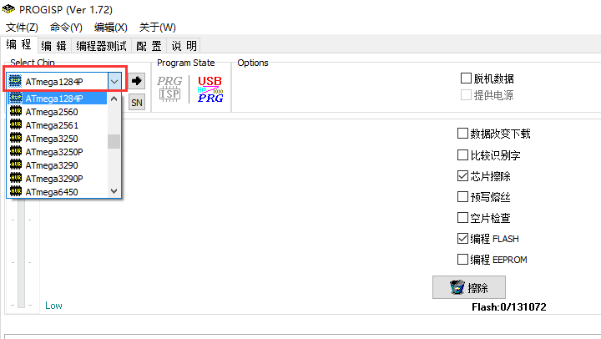
第四步，When you open the software, choose ATmega1284P

Slide 7
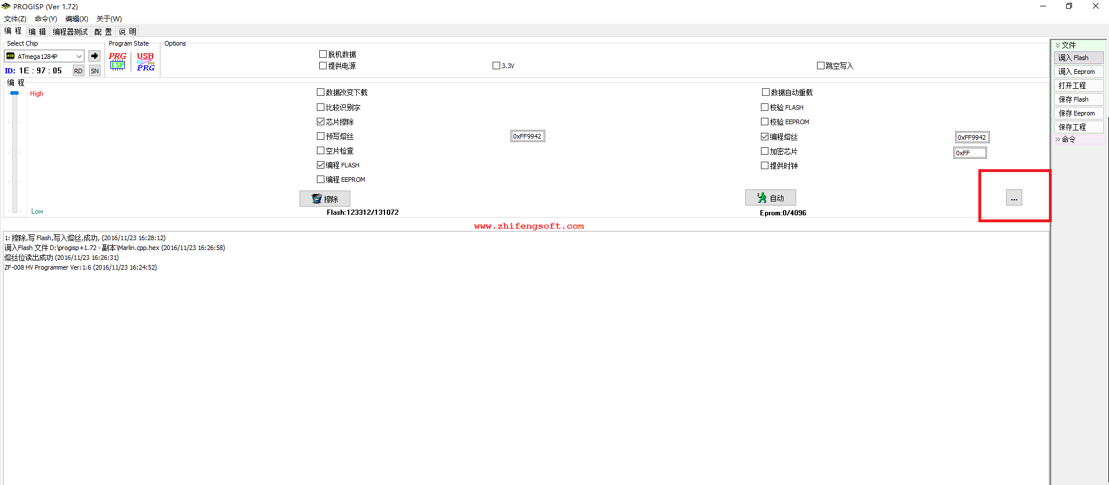
第五步，Click the button as follows“…”

Slide 8
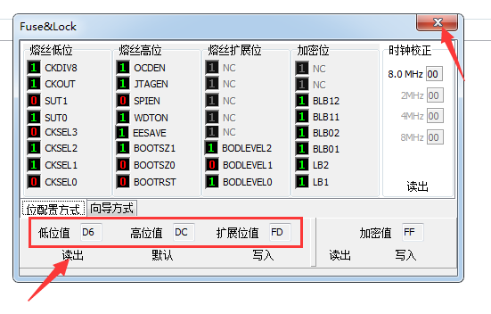
第六步，Click the button ”read”, then click the button”×“
It must show “D6-DC-FD”

Slide 9
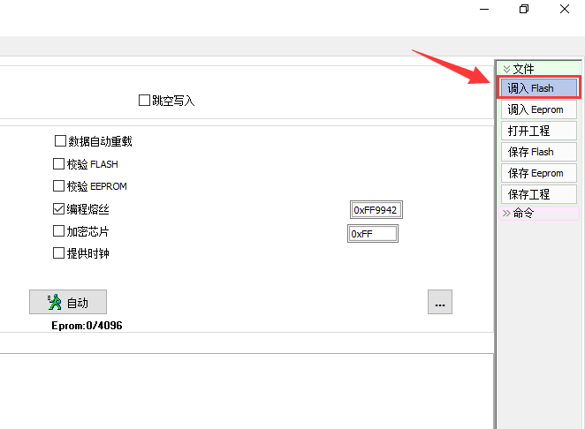
第七步，Click the button ‘调入Flash”

Slide 10
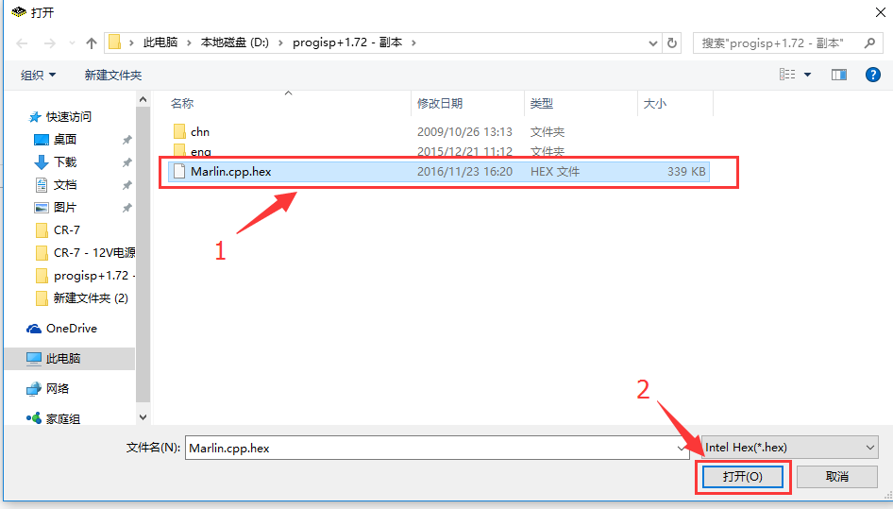
第八步，Choose file”Marlin,cpp,hex” then click the button”open”

Slide 11
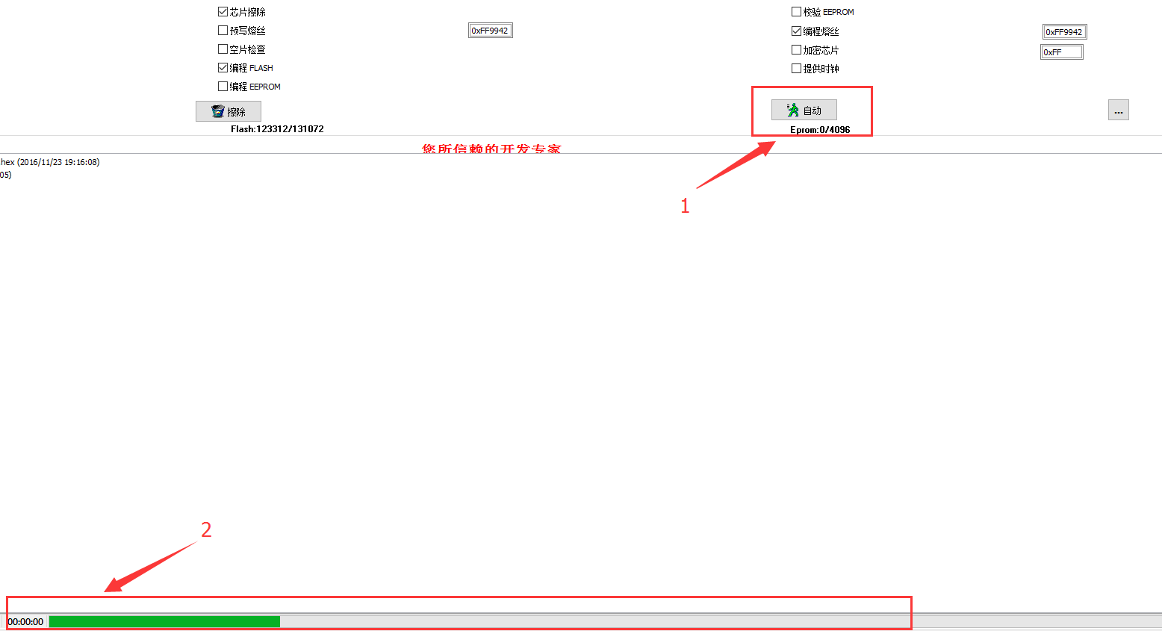
第九步，Click the button“自动”，wait until succeed!

